Slide 1
Triggers

Slide 2
Triggers
A trigger is a set of SQL statements that reside in system memory with unique names.
It is a specialized category of stored procedure that is called automatically when a database server event occurs.
Each trigger is always associated with a table.
A trigger is called a special procedure because it cannot be called directly like a stored procedure.
The key distinction between the trigger and procedure is that a trigger is called automatically when a data modification event occurs against a table.
A stored procedure, on the other hand, must be invoked directly.

Slide 3
The following are the main characteristics that distinguish triggers from stored procedures:
We cannot manually execute/invoked triggers.
Triggers have no chance of receiving parameters.
A transaction cannot be committed or rolled back inside a trigger.
Syntax of Trigger
We can create a trigger in SQL Server by using the CREATE TRIGGER :
CREATE TRIGGER schema.trigger_name
ON table_name
AFTER {INSERT, UPDATE, DELETE}
[NOT FOR REPLICATION]
AS
{SQL_Statements}

Slide 4
When we use triggers?
Triggers will be helpful when we need to execute some events automatically on certain desirable scenarios.
For example, we have a constantly changing table and need to know the occurrences of changes and when these changes happen.
If the primary table made any changes in such scenarios, we could create a trigger to insert the desired data into a separate table.

Slide 5
CREATE TABLE Employee
(
Id INT PRIMARY KEY,
Name VARCHAR(45),
Salary INT,
Gender VARCHAR(12),
DepartmentId INT
)
Next, we will insert some record into this table as follows:
INSERT INTO Employee VALUES (1,'Steffan', 82000, 'Male', 3),
(2,'Amelie', 52000, 'Female', 2),
(3,'Antonio', 25000, 'male', 1),
(4,'Marco', 47000, 'Male', 2),
(5,'Eliana', 46000, 'Female', 3)
SELECT * FROM Employee;

Slide 6
CREATE TRIGGER trInsertEmployee
ON Employee
FOR INSERT
AS
BEGIN
Declare @Id int
SELECT @Id = Id from inserted
INSERT INTO Employee_Audit_Test
VALUES ('New employee with Id = ' + CAST(@Id AS VARCHAR(10)) + ' is added at ' + CAST(Getdate() AS VARCHAR(22)))
END
After creating a trigger, we will try to add the following record into the table:
INSERT INTO Employee VALUES (6,'Peter', 62000, 'Male', 3)

Slide 7
CREATE TRIGGER trDeleteEmployee
ON Employee
FOR DELETE
AS
BEGIN
Declare @Id int
SELECT @Id = Id from deleted
INSERT INTO Employee_Audit_Test
VALUES ('An existing employee with Id = ' + CAST(@Id AS VARCHAR(10)) + ' is deleted at ' + CAST(Getdate() AS VARCHAR(22)))
END
After creating a trigger, we will delete a record from the Employee table:
DELETE FROM Employee WHERE Id = 2;

Slide 8
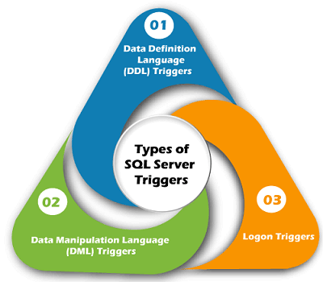
Types of SQL Server Triggers

Slide 9
DDL Triggers
DDL triggers are fired in response to the DDL events, such as CREATE, ALTER, and DROP statements.
We can create these triggers at the database level or server level, depending on the type of DDL events.
It can also be executed in response to certain system-defined stored procedures that do DDL-like operations.

Slide 10
DML Triggers
DML triggers are fired in response to DML events like INSERT, UPDATE, and DELETE statements in the user's table or view.
It can also be executed in response to DML-like operations performed by system-defined stored procedures.
After Triggers
After trigger fires, when SQL Server completes the triggering action successfully, that fired it.
Generally, this trigger is executed when a table completes an insert, update or delete operations.
It is not supported in views. Sometimes it is known as FOR triggers.

Slide 11
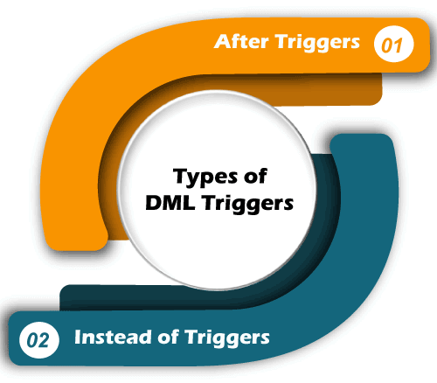

Slide 12
Instead of Triggers
Instead of Trigger fires before SQL Server begins to execute the triggering operation that triggered it.
It means that no condition constraint check is needed before the trigger runs.
As a result, even if the constraint check fails, this trigger will fire. It is the opposite of the AFTER trigger.
We can create the INSTEAD OF triggers on a table that executes successfully but doesn't contain the table's actual insert, update, or delete operations.

Slide 13
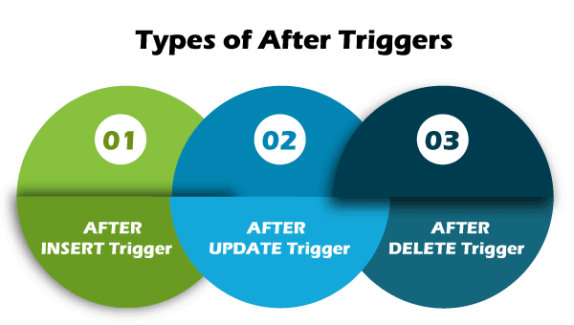

Slide 14
After Triggers syntax in SQL Server:
CREATE TRIGGER schema_name.trigger_name
ON table_name
AFTER {INSERT | UPDATE | DELETE}
AS
BEGIN
-- Trigger Statements
-- Insert, Update, Or Delete Statements
END

Slide 15
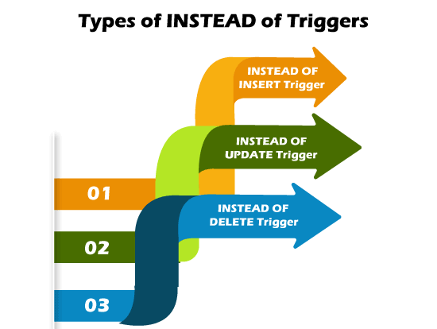

Slide 16
Instead of Triggers syntax in SQL Server:
CREATE TRIGGER schema_name.trigger_name
ON table_name
INSTEAD OF {INSERT | UPDATE | DELETE}
AS
BEGIN
-- trigger statements
-- Insert, Update, or Delete commands
END

Slide 17
Modify Triggers using SQL Command
We can use the ALTER TRIGGER statement to modify the triggers in MS SQL. The following statement allows us to do modifications to the triggers:
ALTER TRIGGER [dbo].[triggers_in_sql]
ON [dbo].[EmployeeTable]
AFTER INSERT
AS
BEGIN
-- Modify as per your needs
END

Slide 18
How to SHOW Triggers in SQL Server?
SELECT name, is_instead_of_trigger
FROM sys.triggers
WHERE type = 'TR’;
How to DELETE Triggers in SQL Server?
DROP TRIGGER [IF EXISTS] schema_name.trigger_name;
If we want to remove more than one trigger at once, we must separate the trigger using the comma operator:
DROP TRIGGER schema_name.trigger_name1, trigger_name2.....n;
We can use the DROP TRIGGER statement in the below format to delete one or more LOGON triggers:
DROP TRIGGER [ IF EXISTS ] trigger_name1, trigger_name2.....n
ON { DATABASE | ALL SERVER };
We can use the DROP TRIGGER statement in the below format to delete one or more DDL triggers:
DROP TRIGGER [ IF EXISTS ] trigger_name1, trigger_name2.....n
ON ALL SERVER;

